Slide 1

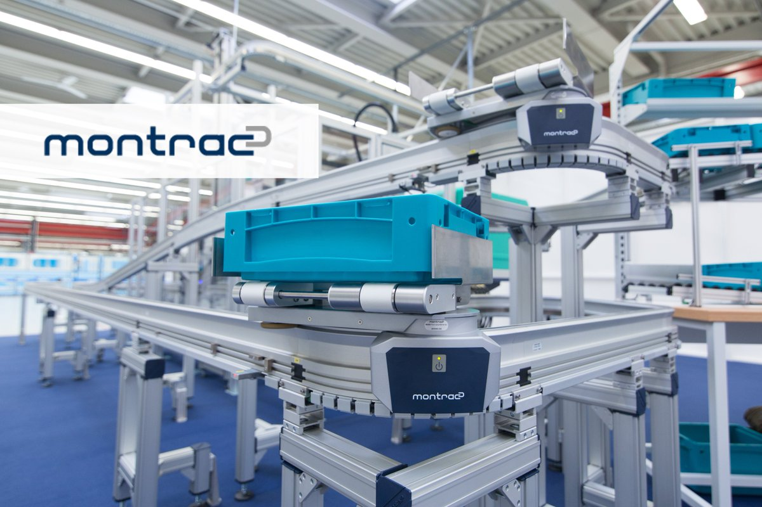
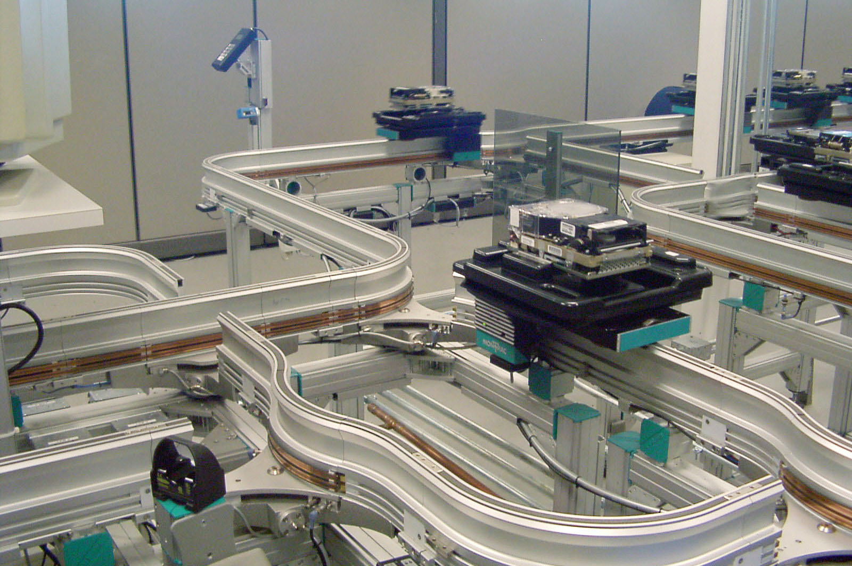

Transport network of a robotic production line
Florent Silva
Lorris Guilloux
Walid Meskine
Thierry Ngoma Mouko

Slide 2
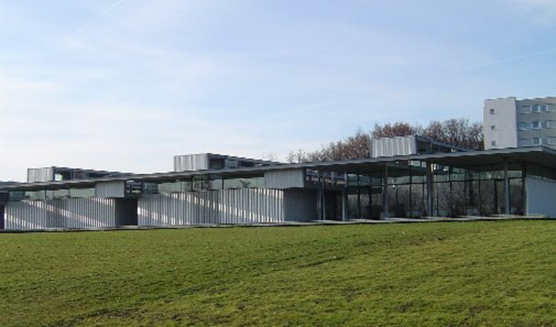
Summary
Introduction
Context
Objectives
Working process
Working environment
Concrete results
Personal experience
Conclusion
AIP-PRIMECA premises

Slide 3

Introduction
“Projet Long” structure :
6 weeks project
Working with engineers
One foot in the professional world
Multi-language experience

Slide 4
Context
Introduction
Context
Objectives
Working process
Working environment
Concrete results
Personal experience
Conclusion

Slide 5
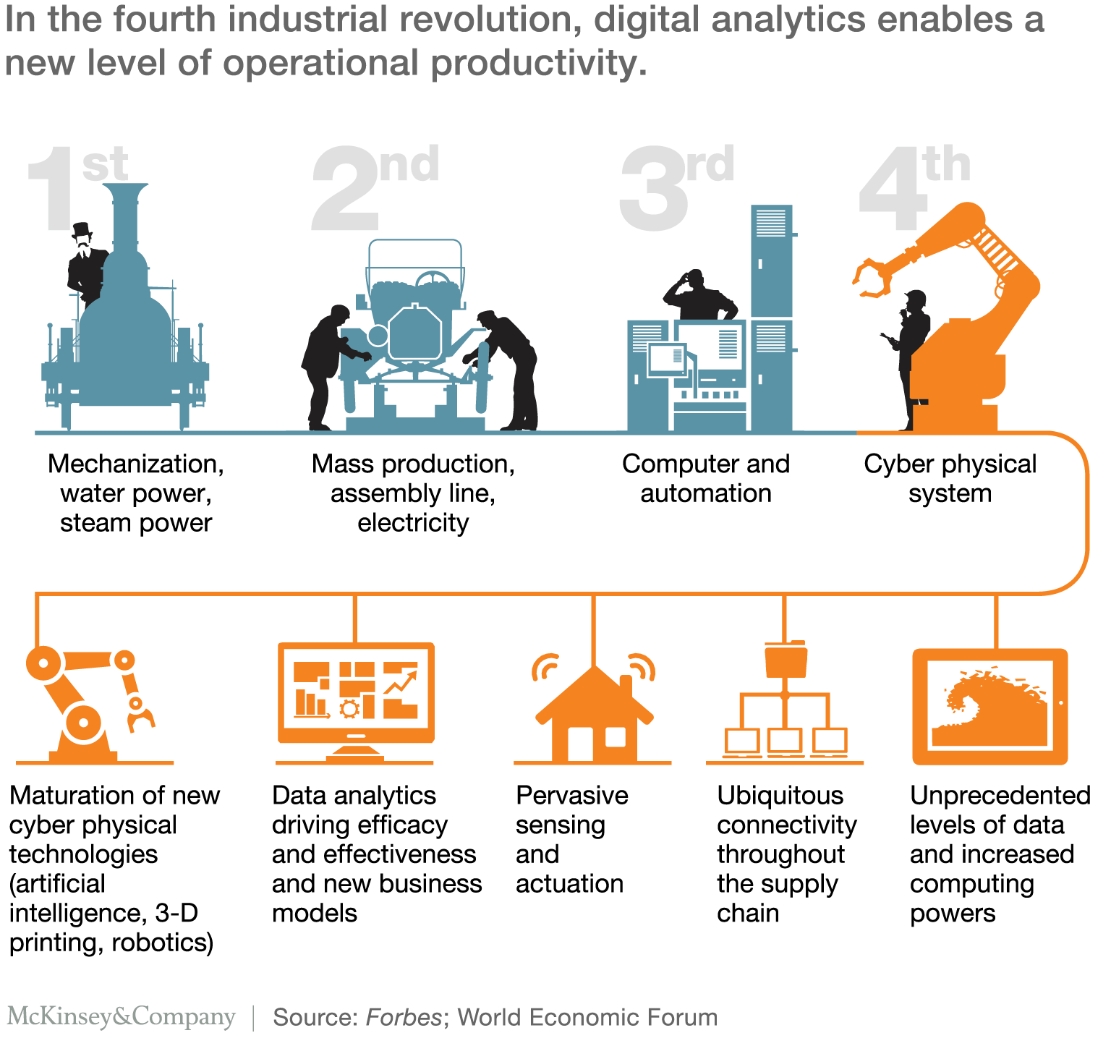
Context
Notes:
1st one 1784 – 2nd 1870 – 3rd 1969 – 4th today

Slide 6
Context

Slide 7
Objectives
Introduction
Context
Objectives
Working process
Working environment
Concrete results
Personal experience
Conclusion

Slide 8

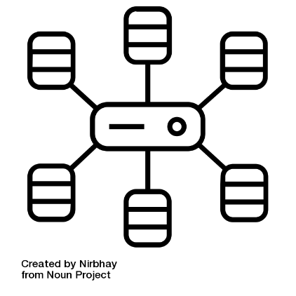
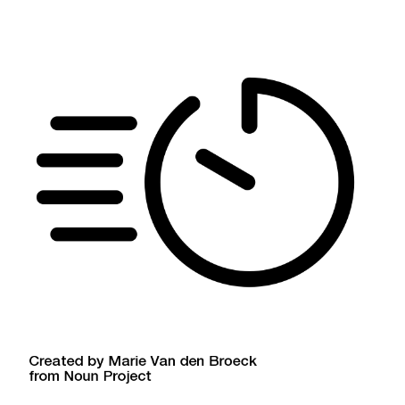
Objectives
Create an educational subject
Main code modification
Speed up the simulation

Slide 9
Working process
Introduction
Context
Objectives
Working process
Working environment
Concrete results
Personal experience
Conclusion

Slide 10
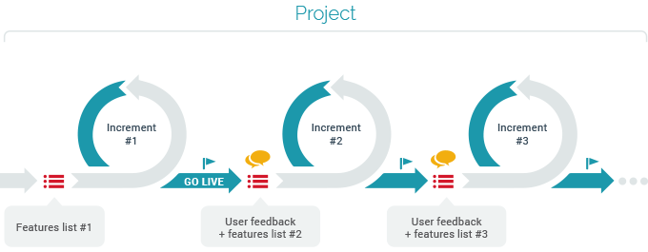
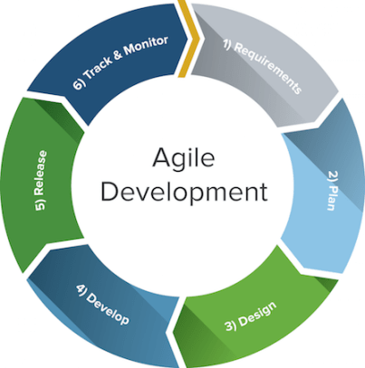
Working process
Agile Method

Slide 11
Working environment
Introduction
Context
Objectives
Working process
Working environment
Concrete results
Personal experience
Conclusion

Slide 12

Working environment
Master
Advertising
Subscribing
Node
Topic
Node
Publication
Callback

Slide 13

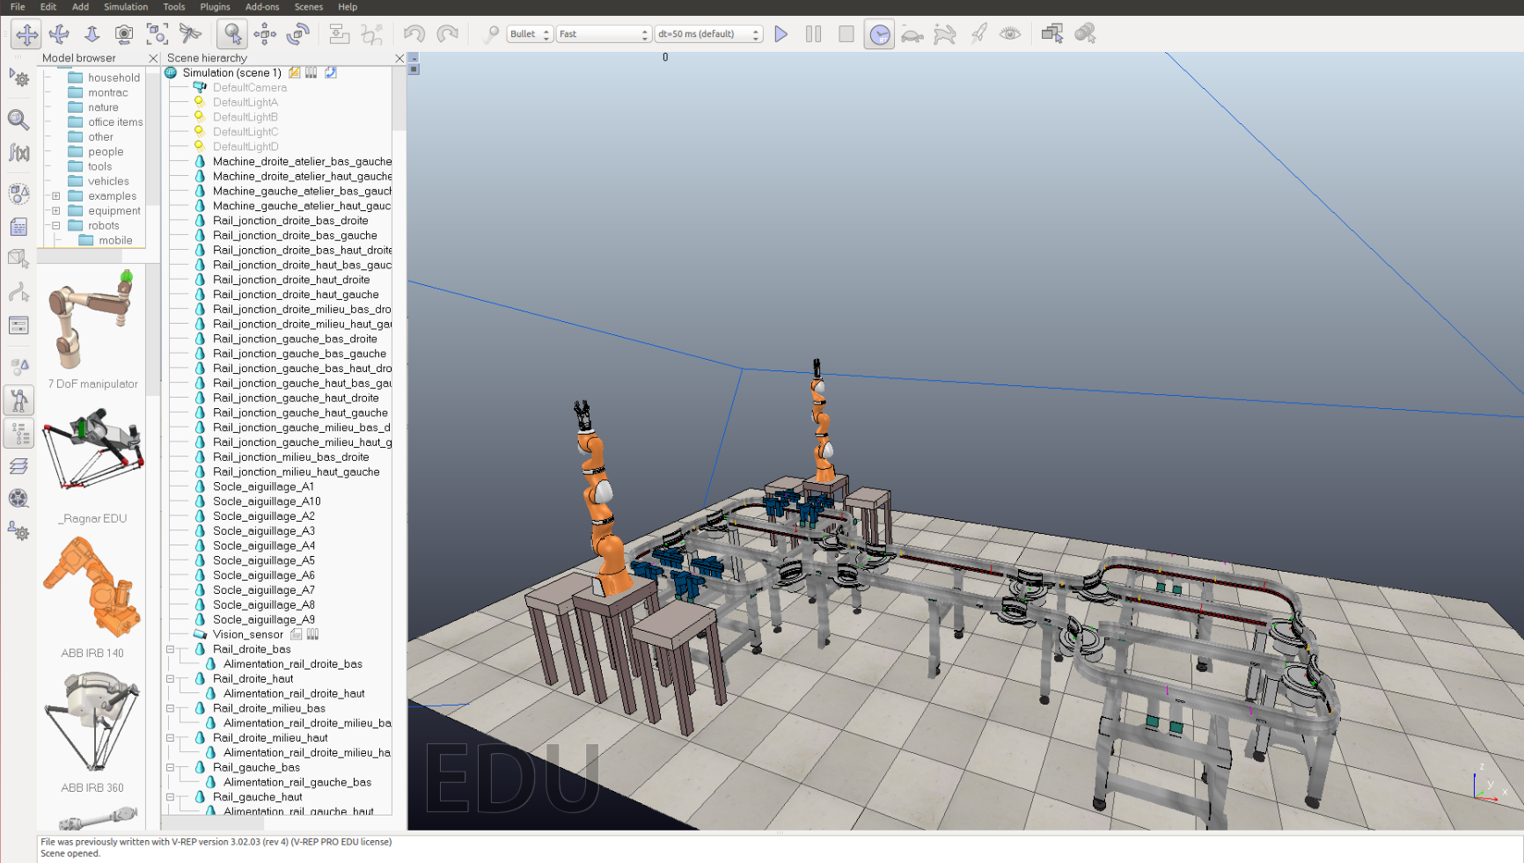
Working environment
Robot models
Scene
Dynamic models

Slide 14










Working environment
Modify the source code
Validation and commit
Compiling + Tests

Slide 15
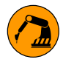
Working environment
System
WS2
WS1
WS8
WS7
WS3
WS4
WS5
WS6

Slide 16
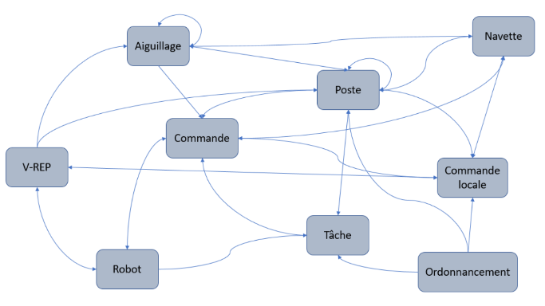
Working environment
Global architecture

Slide 17
Concrete results
Introduction
Context
Objectives
Working process
Working environment
Work and results
Personal experience
Conclusion

Slide 18

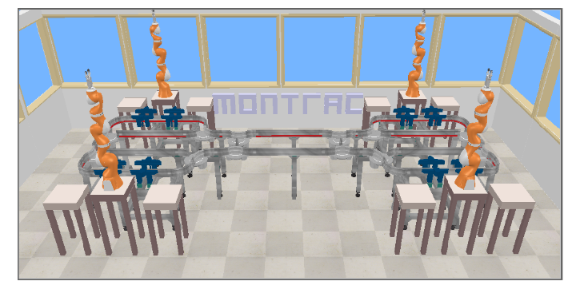
Work and results
Simulation Speed-up

Slide 19
Work and results
Simulation Speed-up
Tests on multiple computers
Step size and calculation methods
Remove of useless objects

Slide 20
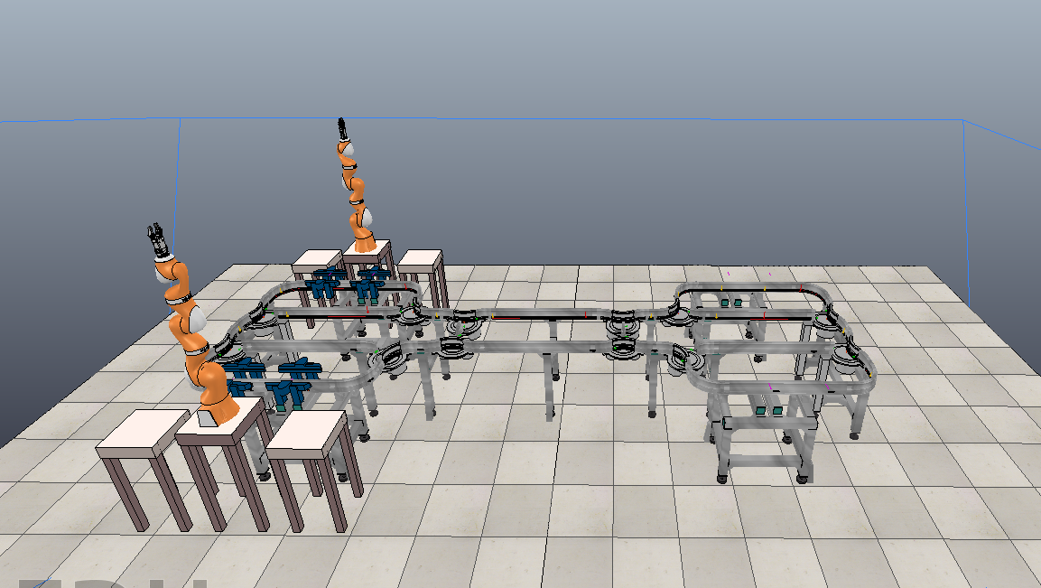

Work and results
Simulation Speed-up

Slide 21



Work and results
Programming update
Setup :
Previous year
This year
Setup
Initialisation file

Slide 22
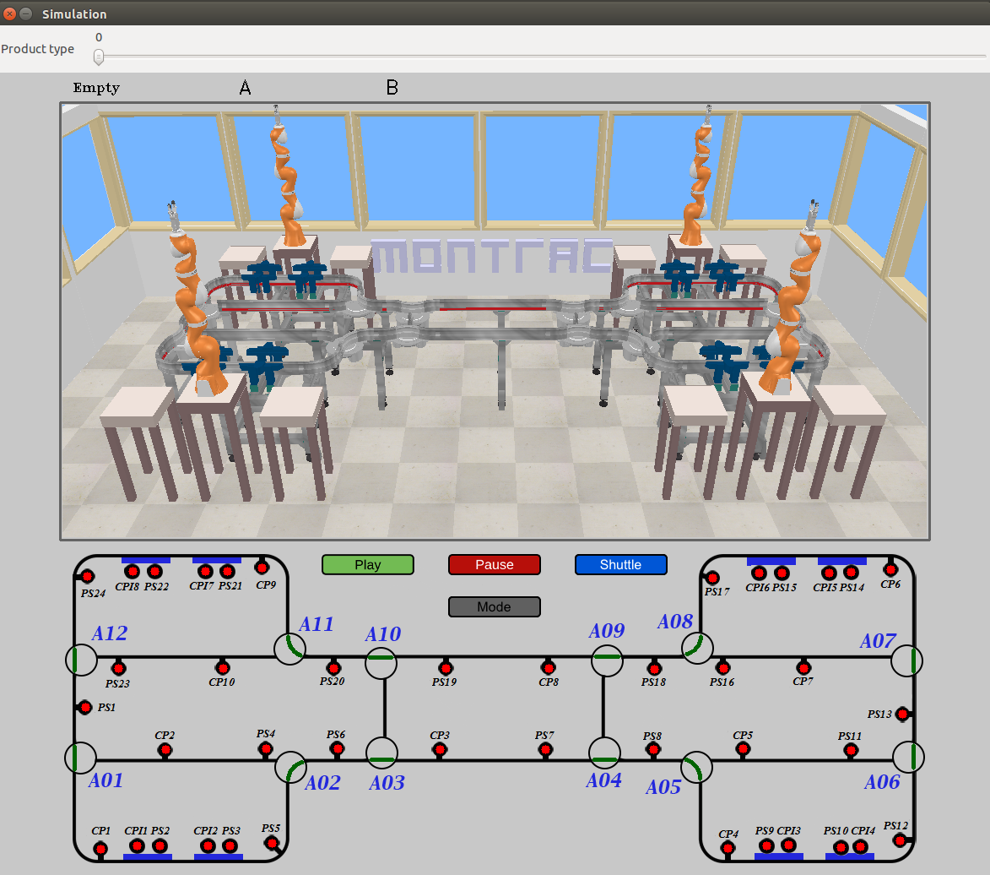
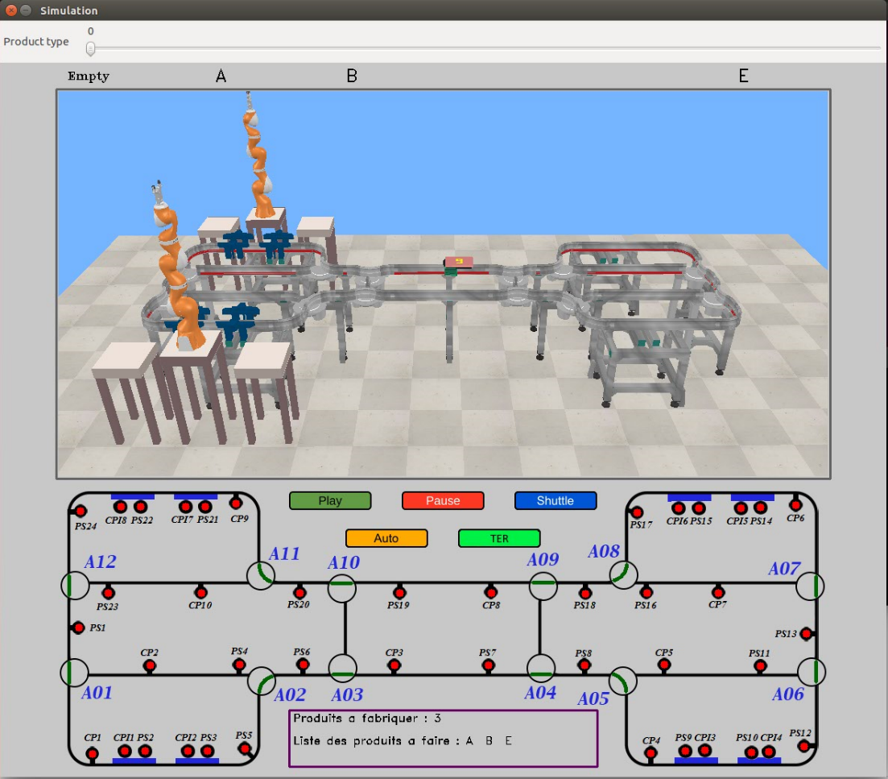
Work and results
Programming update
UI :

Slide 23
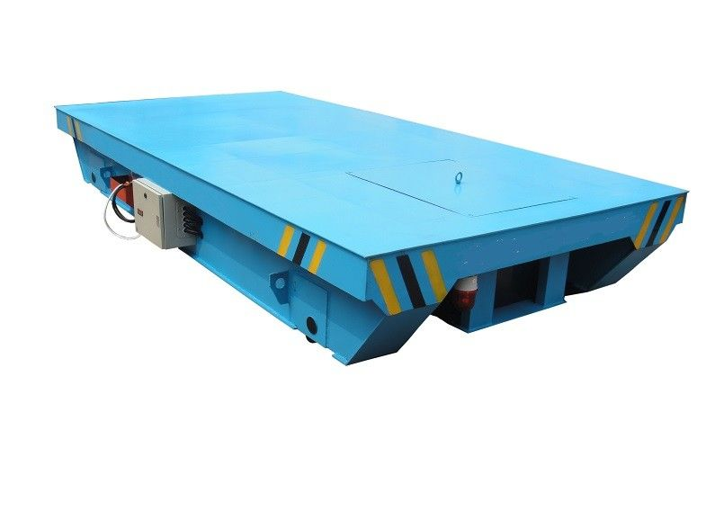

Work and results
Programming update
Product creation :

Slide 24

Work and results
Programming update
Product creation :

Slide 25

Work and results
Programming update
Log file:
Node
Node
Topic
Topic
Node
Topic
Node
Topic
Topic
Node
Node

Slide 26
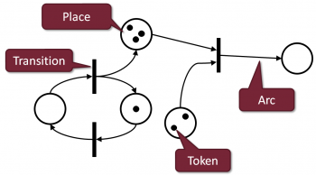


Work and results
TER Subject

Slide 27

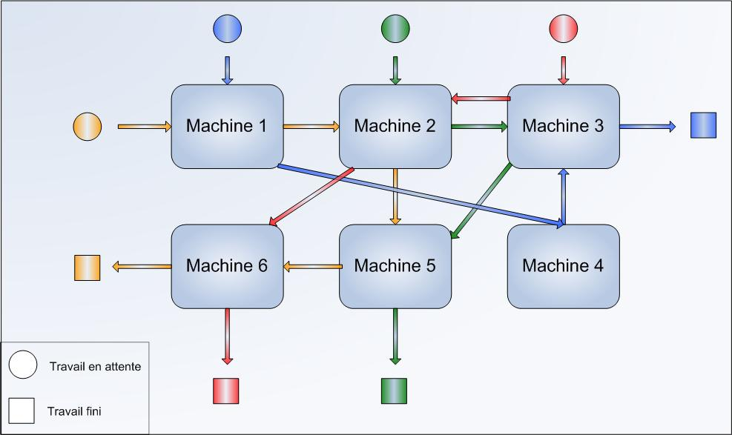
Work and results
TER Subject
Treat multiple products according to a specific production range
ProductConfiguration file
Standby
Done

Slide 28
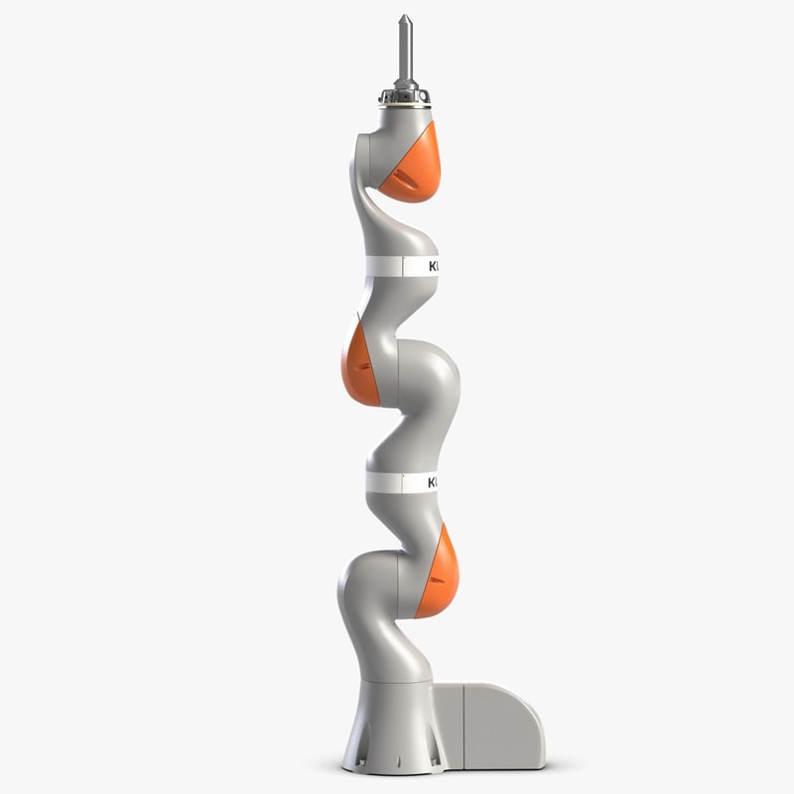

Work and results
TER Subject
High level programming functions

Slide 29
Personal experience
Introduction
Context
Objectives
Working process
Working environment
Concrete results
Personal experience
Conclusion

Slide 30

Personal experience
Teamwork

Slide 31

Personal experience
Project Management

Slide 32
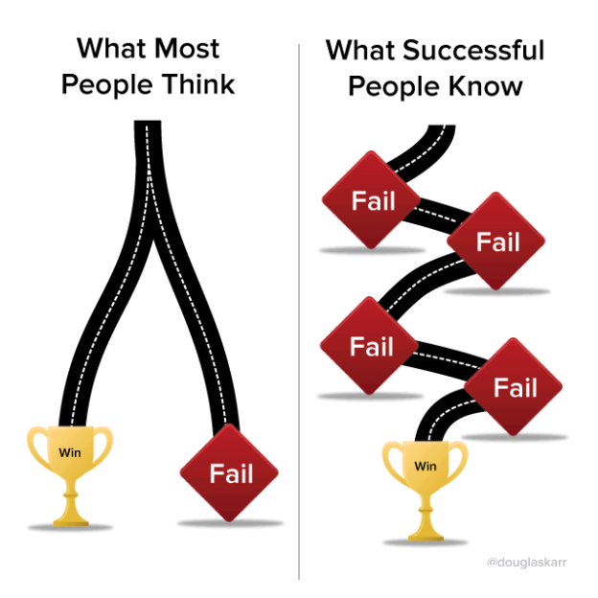
Personal experience
Engineering approach

Slide 33

Personal experience
Difficulties
Carry on an existing project
New working environment

Slide 34
Conclusion
Introduction
Context
Objectives
Working process
Working environment
Concrete results
Personal experience
Conclusion

Slide 35
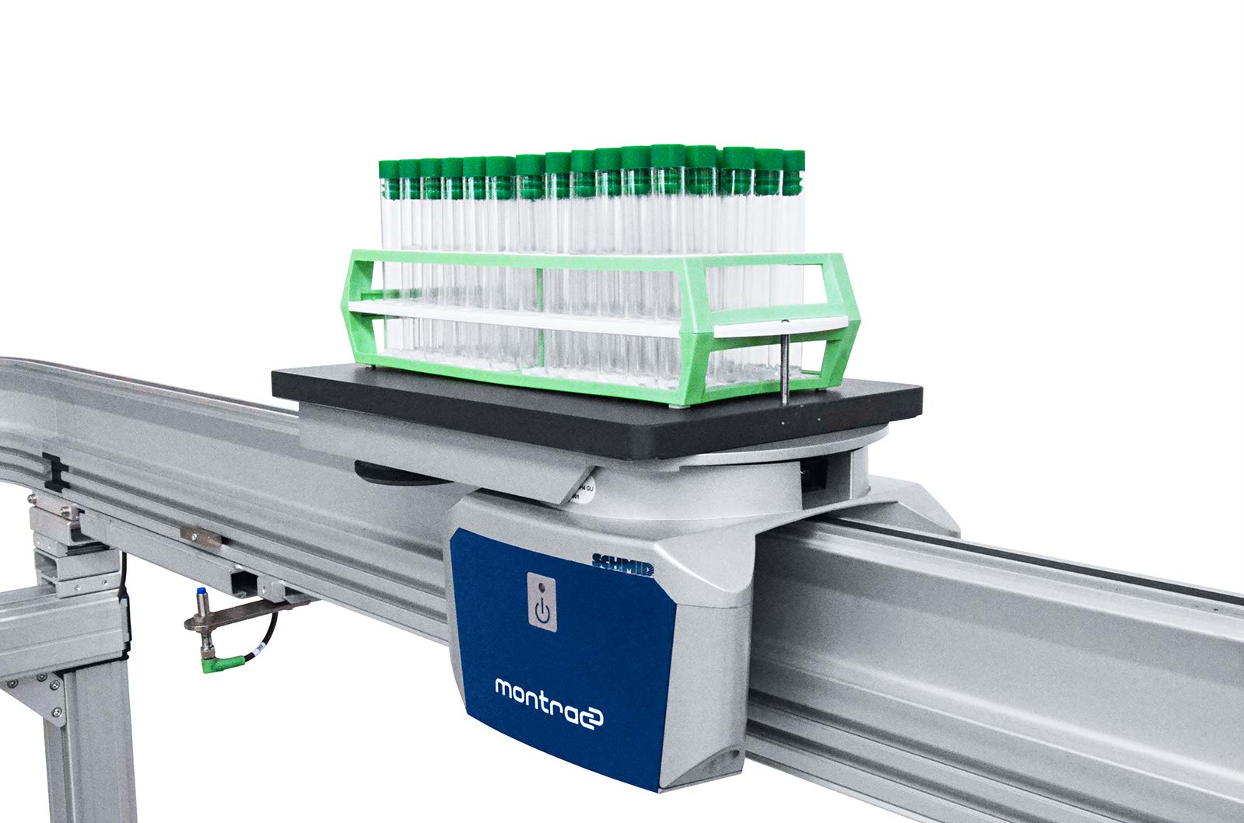

Thank you all for your attention

